Slide 1


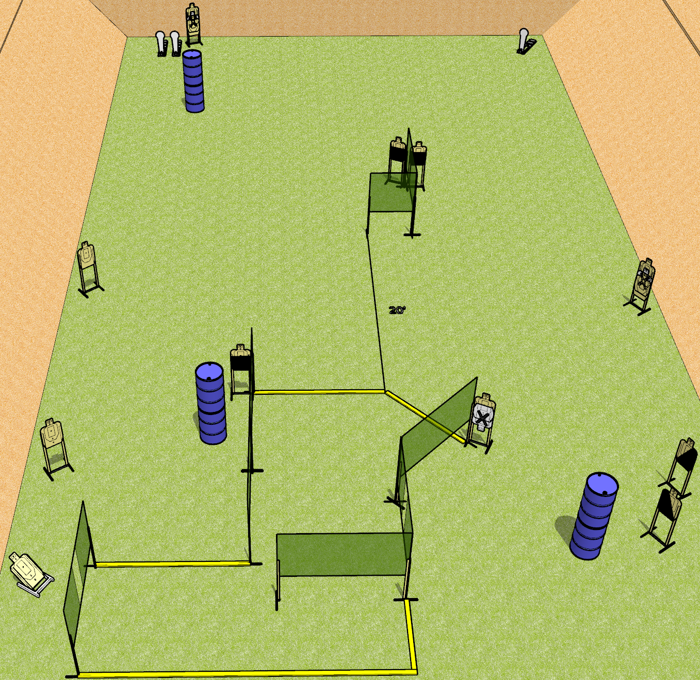
 | Dothan Gun Club – USPSA Match Ride the Lightning Course Designer : Drew Coleman
Round Count 29 rounds 13 USPSA 3 colt poppers
Equipment List 13 wall feet 2 medium fault lines 3 50%, 1 left and 1 right diagonal

Slide 2
Ride the Lightning
Written Stage Briefing
Ride the Lightning is a 29 round, 145 point, Comstock course of fire. There are 13 USPSA targets and 3 colt poppers. The best 2 hits on paper will score, and steel must fall to score. The start signal is audible.
Handgun start position is anywhere completely outside the shooting area, wrists below belt. Handgun is loaded and holstered.
PCC start position is anywhere completely outside the shooting area, stock on belt. Loaded carbine is held with both hands, safety on.
On start signal, engage targets as they become available from within the shooting area.

